Slide 1

Using PROC REPORT and ODS for Customized Reports and for Medical Informatics Sparklines
Beijing, July 2012
Jim Sattler

Slide 2
About the Speaker
Over 20 years of pharmaceutical industry experience
Lecturer in SAS System Programming at University of California, Berkeley.
Instructor for SAS Manila, SAS Singapore and SAS Middle East.
Numerous publications and conference papers

Slide 3
Preface - Information is The Music of Data
Clear communication of the “music” is our goal
Sometimes, we don’t communicate clearly
Let’s look at a few famous examples
of misunderstood lyrics in popular songs.

Slide 4
Misunderstood Lyrics
There's a bathroom on the right
There's a bad moon on the rise
Artist: Creedence Clearwater Revival

Slide 5
Misunderstood Lyrics
'Scuse me while I kiss this guy
'Scuse me while I kiss the sky
Jimi Hendrix

Slide 6
Misunderstood Lyrics
I left my brains down in Africa
I bless the rains down in Africa
Artist: Toto

Slide 7
Misunderstood Lyrics
Now I've had a time with your wife
Now I've had the time of my life
Artist: Bill Medley & Jennifer Warren

Slide 8
Presentation Overview
The evolution of ODS
ODS text enhancements to reports
ODS Graphics enhancements to reports
Medical information in oncology trial
Enhancing reports with sparklines
Special considerations

Slide 9
The Evolution of ODS
First introduced in SAS Version 7
Similar to evolution of graphics from line printers to full color graphics
Different devices – different destinations
Also, like graphics, very rich in detailed custom features
ODS Graphics – Graphics moved to BASE SAS V9.3

Slide 10
Abundance of customization features
Traffic lighting
Column header rotation
Font types and sizes
Cell size management

Slide 11
Styles and Style Elements
SAS Institute provides some style definitions.
A global style name specifies the general appearance of output.
Style elements specify the appearance of details in the output.

Slide 12
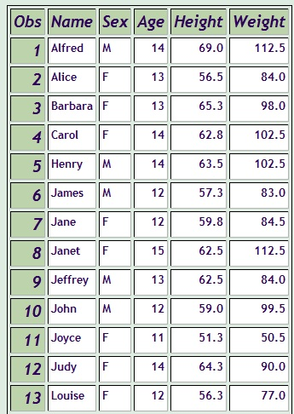
One Example - Ocean Style

Slide 13
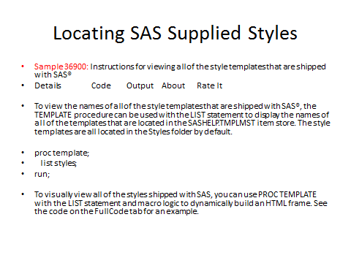

Slide 14
Style-element-names Used in Reporting
Style elements are part of a style definition that is registered with the Output Delivery System.
Users can create their own style definitions and style elements with PROC TEMPLATE.

Slide 15
Information to be Delivered
The reviewers want to see patients with increases in hypertension.
The report must show patients who had a significant change in their blood pressure since the baseline visit.

Slide 16
Custom Features
Present the information in landscape mode across cycles.
Special Consideration – landscape mode may be suitable for a printed report but not for reviewers who use tablets with data in portrait mode.
Treatment groups should be easy to identify

Slide 17
General Form of PROC REPORT
PROC REPORT DATA=library.filename <option(s)>;
COLUMN column-specification(s);
DEFINE report-item / <usage> <attribute(s)>
<option(s)> ;
COMPUTE report-item </ type-specification>;
. . . select SAS language elements . . .
ENDCOMP;
BREAK location break-variable</ option(s)>;
RBREAK location </ option(s)>;
RUN;

Slide 18
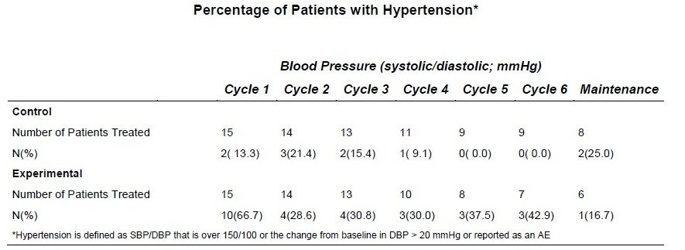
Customized Report

Slide 19
Customizing the Display - 1
Present the data in landscape mode
Specific Technique - Take advantage of the “across” definition of a variable.

Slide 20
PROC REPORT – Display Data in Landscape Mode for Clarity
proc report data=combine_all center missing nowd split='*’ style(header)={font_size=11pt font_weight=bold};
column reporder header category cycle,contN;
define reporder / group noprint;
define header / group noprint;
define cycle /across width=50 'Blood Pressure (systolic/diastolic; mmHg)';

Slide 21
Customizing the Display - 2
Highlight the different treatment groups for ease of interpretation
Manage the placement and appearance of headers and footers for good overall layout
Specific technique – PROC REPORT Compute Blocks
Level of detailed control comes close to DATA _NULL_ capabilities

Slide 22
Using the Compute Block
The Compute Block opens up many possibilities for custom reporting and computations.
The Call Define statement can be used inside a Compute Block in PROC REPORT.

Slide 23
CALL DEFINE Syntax
A CALL DEFINE statement sets the value of an attribute for a particular column or row in the current row.
The CALL DEFINE statement has three arguments.
CALL DEFINE (column-id,attribute-name, value);

Slide 24
First Compute Block Highlights Control and Experimental Groups
compute category;
if header='Y' then
do;
call define(_col_,'style','style={font_weight=bold}');
end;
endcomp;

Slide 25
Second Compute Block Manages Header Placement and Appearance
compute before _page_ /
style={font_face=Arial font_size=12pt font_weight=bold just=c};
line "Percentage of Patients with Hypertension*” ;
endcomp;

Slide 26
Third Compute Block Manages Footer Placement and Appearance
compute after _page_ /
style={font_face=Arial font_size=8pt font_weight=medium just=l};
line "*Hypertension is defined as SBP/DBP that is over 150/100 or the change from baseline in DBP > 20 mmHg";
endcomp;

Slide 27
Special Characteristics for Another Report
Fit a large number of columns on one page
Drug-AE relationship columns should have a “spanned header”.

Slide 28
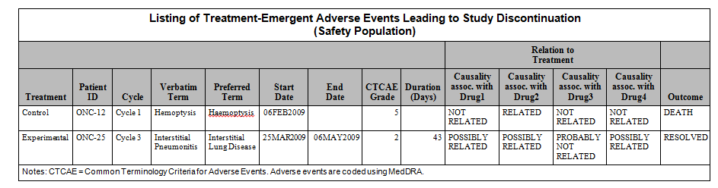
Fitting Many Columns and Using Spanned Header

Slide 29
Technique for Spanning Headers
column trt subjid cycle aeterm aedecod aestdta aeendta aetoxgrn duration
('Relation to*Treatment' aerelc4 aerelbv aerelcb aerelpc) aeout;

Slide 30
Technique for Fitting Many Columns
column trt subjid cycle aeterm aedecod aestdta aeendta aetoxgrn duration
('Relation to*Treatment' aerelc4 aerelbv aerelcb aerelpc) aeout;
define trt /style(column)={cellwidth=110} 'Treatment' order=data;
define subjid /style(column)={cellwidth=80} order 'Patient*ID';
define cycle / style(column)={cellwidth=80} 'Cycle';
define aeterm / 'Verbatim*Term';
define aedecod / 'Preferred*Term';
define aestdta /style(column)={cellwidth=100} 'Start*Date';
define aeendta /style(column)={cellwidth=100} 'End*Date';
define aetoxgrn /style(column)={cellwidth=80} format=3. 'CTCAE*Grade';
define duration / style(column)={cellwidth=90} 'Duration*(Days)';
define aeout /style(column)={cellwidth=100} 'Outcome';

Slide 31
Technique for Fitting Many Columns
Cell Style Attributes can be defined using several kinds of measurements, such as inches and centimeters.

Slide 32
Special Consideration
In the report just shown here, the width is defined in pixels.
That definition works well for this RTF output but will be ignored if the output is going to HTML.

Slide 33
Cell Style Attributes
Attribute | Sample Values
CELLWIDTH CELLHEIGHT | 150, 2 in, 5 cm, 20%
CELLSPACING CELLPADDING | 0, 7, .1 in, 1 cm, em, ex, pt
JUST | left, dec, center, right l, d, c, r
VJUST | top, middle, bottom t, m, b
URL | "http://support.sas.com"

Slide 34
Many Other Kinds of Customization Are Available
Color can be used to differentiate among classes of data
This is called “traffic lighting”.
For example, color can show different age groups.

Slide 35
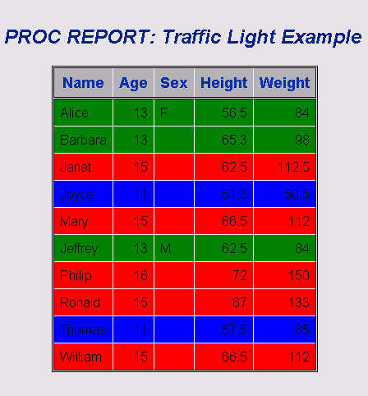

Slide 36
proc report data=sashelp.class nowd;
column name age sex height weight;
define name / display;
define age / display;
define sex / order;
define height / display;
define weight / display;
compute age;
if age <= 12 then call
define(_row_,"style","style={background=blue}");
else if 12< age <14 then call
define(_row_,"style","style={background=green}");
else call define(_row_,"style","style={background=red}");
endcomp;
run;

Slide 37
Using and Overusing Styles
Reports should be easy to read and understand.
Judicious use of style elements can improve the readability of a report and communicate meaning clearly.
Too much embellishment for its own sake may be distracting and may look bad.

Slide 38

Be Careful – Don’t Overdo It

Slide 39
ODS Graphics Enhancements to Reports
The Importance of Clear Communication
Misinterpretation of Graphical Information
New ODS Graph Capabilities of Interest to Statisticians
ODS Graph Isn’t Only for Statisticians
“Sparklines” a new way to combine ODS graphics with reporting for medical informatics

Slide 40
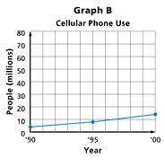
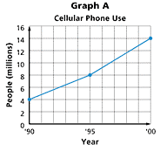
Misinterpretation of Graphical Information
Why does Graph A look different than Graph B? Both the graphs represent the same data.

Slide 41
New ODS Graph Capabilities of Interest to Statisticians
ODS Statistical Graphics
Automatically created with procedures
PROC REG can display a default panel of regression diagnostic plots
PROC GLM can display a default grouped box plot of response values when you specify a one-way analysis of variance model

Slide 42
ODS Graph Isn’t Only for Statisticians
Statistical data presentation is one way to use ODS Graphics
New ODS Graphics capabilities can also support medical informatics
ODS Graph statements can be part of a program to generate micrographs called “sparklines” that can be inserted into PROC REPORT output.

Slide 43
Sparklines – A New Possibility with ODS Graphics
Edward Tufte’s theory
Loose interpretation in current practice
SAS currently focused on implementation in BI
Medical information example
How to create sparklines in ODS Graphics that comply with classical theory, meet medical information needs, and include them in reports

Slide 44
Edward Tufte’s Theory
Sparklines defined as “data intense, simple, word-sized graphics”.
The basic idea is that information is sometimes easier to understand when it is compressed into a scale and density comparable with text.
Can be useful for medical informatics

Slide 45
Current Renditions of Sparklines in SAS
The term “sparklines” is used loosely
It’s common to find simple trend lines, without a gray band
Until recently, sparklines needed complex SAS/Graph techniques like Annotate
Special downloadable Bissantz fonts have been another way to produce them
SAS focusing on BI implementation.

Slide 46
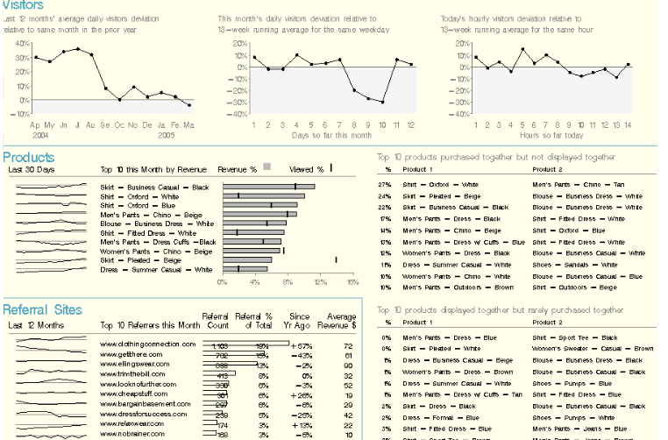
SAS BI Dashboard Sparklines

Slide 47
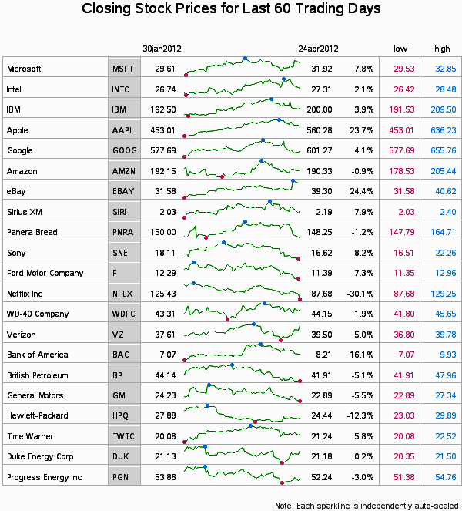

Slide 48

Tufte’s Clinical Sparklines
The task Tufte outlines is to detect deviations from normal limits, visual deviations outside the gray band. His rendition looks like this:

Slide 49
Many Possible Medical Uses for Sparklines
Display glucose measurements for 100 patients on a single page.
Monitor platelets during heparin administration
Display intraocular pressure control and visual field changes for glaucoma management .

Slide 50
Oncology Example
Oncology “dosing to tolerable toxicity”
Measuring the best way to dose is important
Chemo/Radiation tends to wipe out fast reproducing cells such as platelets but also lymphocytes/leucocytes.
Leukopenia and neutropenia are potential concerns for medical monitors.

Slide 51
A Sparkline Report Can Communicate Relevant Hematology Information
Subjects’ hematology data can be graphed in the form of sparklines using ODS Graphics
The test results can be included in a report generated by PROC REPORT.
A medical reviewer of the data can understand the results quickly.

Slide 52
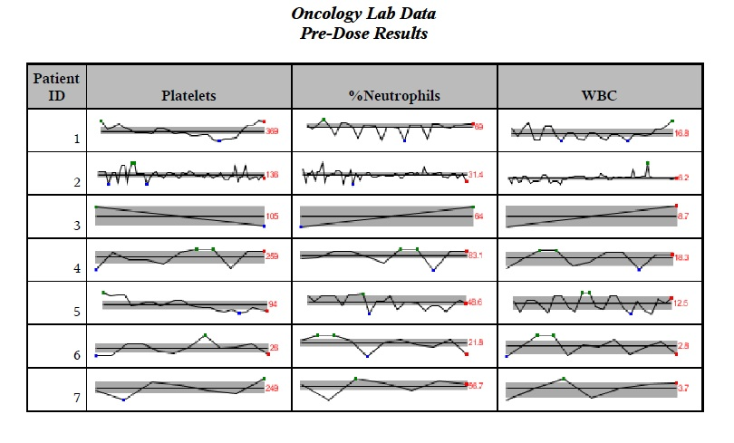

Slide 53
New SAS Technique for Sparklines
Use the SAS Macro language to iterate the generation of sparklines for selected datasets and subjects
Create mean, max, min and percentile parameters for each subject and also the final data point
These will be the input variables for sparkline micrographs.

Slide 54
Step 1 - Use Macro Language
%macro sparkline (data_set, var_name, upper_limit, lower_limit, title_word, stype, minmax);

Slide 55
Step 2 – Create Summary Variables
proc means data=&data_set noprint;
var &var_name;
class subjidn;
output out=avg(where=(_TYPE_=1)) mean=avg p25=p25 p75=p75 min=min max=max;
run;

Slide 56
Step 3 – Create Graph Variables from Summary Variables
u="&upper_limit";
if u='75TH' then ul=&p75;
else ul="&upper_limit";
l="&lower_limit";
if l='25TH' then ll=&p25;
else ll="&lower_limit";
x=_n_;
z=&avg.;

Slide 57
Step 4 – Define Size and Destination
Adjust the overall size of the sparkline. For example: width=1.95in height=.3in
Output each micrograph to a file in a directory, with a macro name that includes dataset name and subject number.

Slide 58
Define Output and Size
Characteristics
data _null_;
call symputx('name',"&data_set"||left(&i));
/* &i comes from Macro do loop */
run;
filename odsout 'c:\temp\gseggifs';
/* Filename specification depends on OS */
ods graphics / reset noborder width=1.95in height=.3in imagename="&name";

Slide 59
Step 5 – Generate the Sparkline
Pass the parameters into a PROC SGPLOT program that creates a background band for each sparkline
SGPLOT also does the line plotting.

Slide 60
Sample Code to Create Sparkline
proc sgplot data=spark noautolegend;
band x=x lower=ll upper=ul / fillattrs=(color=grayaa) ;
series x=x y=&var_name / lineattrs=(color=black thickness=2px) ;
series x=x y=z / lineattrs=(color=black thickness=2px)
curvelabel="&lastone"
curvelabelattrs=(size=12pt color=red);
scatter x=x y=e / markerattrs=(symbol=circlefilled color=red );
scatter x=x y=min / markerattrs=(symbol=circlefilled color=blue );
scatter x=x y=max / markerattrs=(symbol=circlefilled color=green );
xaxis display=none;
yaxis display=none;
run;

Slide 61
Step 6 - Include Sparklines in Report
PROC REPORT NOWD;
COLUMN SUBJID PLATELETS;
compute platelets /char;
call define(_col_,'style','style=[preimage=
"c:\temp\gseggifs\platelet&i..png"]');
endcomp;

Slide 62
ODS Graphics Advantages for Sparklines
Simpler to program than the Annotate Facility
data anno;
set spark;
function='move'; xsys='1'; ysys='2';
x=3; y=ll;
output;
function='bar'; xsys='1'; ysys='2';
x=100; y=ul;
color='ligr'; style='solid';
line=0; when='b';
output;
run;

Slide 63
ODS Graphics Advantages for Sparklines
In Version 9.3 ODS Graphics are included in the Base software license.
Sparkline micrographs can be included in PROC REPORT output using familiar Compute Block methods.

Slide 64
Special Considerations
The simplicity of sparklines does not eliminate the need for good specifications
Sparklines also can be misinterpreted
Tufte’s sparklines show final values
Should they show final values for subjects who did not complete all visits?

Slide 65
Conclusion - Reality Tested
Journal of American Medical Information Association 2010 study concluded that:
“Physicians were able to assess laboratory data faster with sparklines.”
“ Furthermore, these compact graphics enable more information to be presented in a single view and thus reduce the need to scroll or flip between screens. “

Slide 66
Conclusion – A Bright Future
New features in SAS ODS make it possible to communicate text and graphic information clearly in PROC REPORT output.
Version 9.3 ODS Graphics enable all aspects of the work to be done in Base SAS, thereby opening up these capabilities to many users.

Slide 67
Thank You!
A SAS Alliance Partner

