Slide 1
A web based Project Management and Tracking System
Zheng Wang, Yuntian Zhao, Yanhong Li
Email: Zheng.Wang@Merckgroup.com
Biostatistics & Statistical programming
R&D Beijing Hub
Merck Serono (Beijing) Pharmaceutical R&D Co., Ltd.

Slide 2
Outline
Motivation
Introduction
Whole system - working process
  part 1 : Input from Xls and collect data/information from folders
  Part 2 : Datasets and Structure
  Part 3 : Output by HTML/XML/Email
Solution
  Tracking projects progress
  Improve efficiency and accuracy
  Decision support
Summary
Future work

Slide 3
Motivation - Time is money…
Time
Cost
Resource
  Resource is limited and labour cost is high
Our expectations
  Save time and cost
  With the limited resources to create unlimited value
How to exceed our expectations
  By developing a web based project management and tracking system with SAS

Slide 4
Introduction
We build this system to reduce time and costs
How does it work
  First, through two input methods, we define general information, such as table name and ID of programmer, as well as read attribute and status of folders and files
  Second, based on Subject-level Data structure and Basic Data Structure, we save all operations over there and record every change from APTS’s database into a log database
  Lastly, we create output view, view to HTML or XML, and update information through Emails.
What have we achieved from this tracking system
  This tracking system allows users to trace almost everything we have done for projects
    It helps us find out up-to-date information of projects progress
    Users can easily review and examine the changes
    Make a follow-up analysis to benefit management team making decisions of future work

Slide 5
What do we do?
What does system do?
Do all programming work
List of output
Assign programmer and/or validator
Update datasets and documents
Make decisions ?
Creates SAS files with template
Checks log errors and the existence of outputs in PDF, Word or List file format
Compares two versions of outputs and find out the differences between them. Generate finding report in a easy-to-review format
Reminds any updates through Emails
Backs up important folders and files

Slide 6
Why do we need such a System?
Upon completing design and coding, we will leave everything else to this Tracking System
Make tracking work much easier and clearer
  Hyperlink
  Highlight
  Difference between two versions of outputs
Help us find out up-to-date information of project progress
Most importantly, to improve efficiency and reduce costs

Slide 7
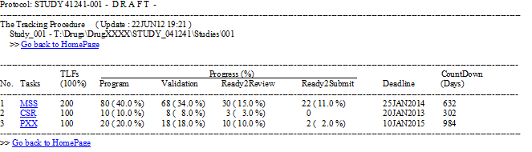
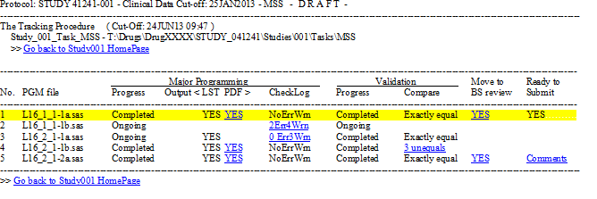
What does the System do?

Slide 8
Working process ( 1/7 )
Project 001
Title.xls
Export
CSV
Subject-level
Structure
BDs Structure
Project 001
tmpfolder
Basic
info
Project001
Predefine
Create / update
View
View N
View 2
Subpage N
HTML or XML
View 1
Subpage 2
HTML or XML
Project 002
Title.xls
Export
CSV
Project001
Subpage 1
HTML or XML
setIndex to DB
Project002
Project 002
tmpfolder
Project 003
Title.xls
Export
CSV
Predefine
Create / update
View
View N
View 2
Subpage N
HTML or XML
View 1
Subpage 2
HTML or XML
Project002
Subpage 1
HTML or XML
Input
Xls or Folders
Datasets
Output
HTML or XML
Import
Into
Dataset
setIndex to DB
Project003
Project 003
tmpfolder
Predefine
Create / update
View
View N
View 2
Subpage N
HTML or XML
View 1
Subpage 2
HTML or XML
Project003
Subpage 1
HTML or XML
setIndex to DB
Project 010
Title.xls
Export
CSV
Project010
Project 010
tmpfolder
Predefine
Create / update
View
View N
View 2
Subpage N
HTML or XML
View 1
Subpage 2
HTML or XML
Projects Folder
Project010
Subpage 1
HTML or XML
Projects Folder
Predefine
Getinfo and
Update
setIndex to DB
Predefine
Create / update
View
Home page

Slide 9
Working process ( 2/7 )
Project 001
Title.xls
Export
CSV
Two types of input methods
  Excel file:
    Listing of outputs to define general information, such as table name / numbers, ID of programmer / validator, types of validation, etc.
  Folder and file information:
    Read attribute and status of files
Project 002
Title.xls
Export
CSV
Project 003
Title.xls
Export
CSV
Import
Into
Dataset
Project 010
Title.xls
Export
CSV
Projects Folder
Predefine
Getinfo and
Update

Slide 10
Working process ( 3/7 )
    For listing of output (Excel file)
MS Excel (VB)
SAS file
Import SAS dataset
Compare new with old
Edit .xls file
Yes
Old dataset exists?
On save
Get difference
No
Create new dataset
Create .csv file
Update major dataset
.bat

Slide 11
Datasets
Working process ( 4/7 )
Subject-level
Structure
BDs Structure
Two types of Data Structure
  For general information:
    Subject-level Structure.
  For project tracking information:
    Basic Data Structure.
  For Log Database:
    Catch any action on any major dataset and save into LogDB.
    Roll-back major dataset from LogDB if there is any mis-operation that exists.
Project001
Predefine
Create / update
View
Basic
info
setIndex to DB
Project002
Predefine
Create / update
View
Import
Into
Dataset
setIndex to DB
Project003
Predefine
Create / update
View
setIndex to DB
Project010
Predefine
Create / update
View
Predefine
Getinfo and
Update
setIndex to DB
Predefine
Create / update
View

Slide 12
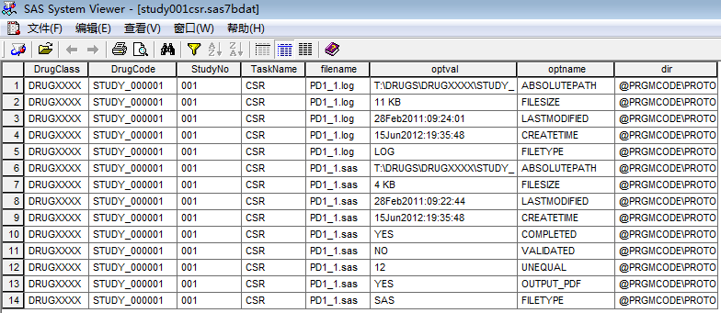
Working process ( 5/7 )
For project tracking information
    Basic Data structure

Slide 13
Working process ( 6/7 )
    Log Database catch action
      One of the core technical parts of this system is that it will record every change from APTS’s database into a LOGDB which could provide a roll-back function to make sure all information on website being accurately and correctly transferred.
For each action
On Datasets
(insert, delete, modify)
Basic info
Project001
Operate
Project002
Project003
Mis-operation
Project010
LogDB
(record each action / value change from
xx to yy)
Read selective
Information
from LogDB
Roll-back
datasets
from LogDB
Operate

Slide 14
Working process ( 7/7 )
Output
HTML or XML
Output to view and HTML file
  First step:
    Creat output view
    Set an index key back to major dataset for future update.
  Second step:
    View to HTML or XML
    Update information through Emails
    Send error or warning message to administrator through Emails
Project 001
tmpfolder
Predefine
Create / update
View
View N
View 2
Subpage N
HTML or XML
View 1
Subpage 2
HTML or XML
Project001
Subpage 1
HTML or XML
setIndex to DB
Project 002
tmpfolder
Predefine
Create / update
View
View N
View 2
Subpage N
HTML or XML
View 1
Subpage 2
HTML or XML
Project002
Subpage 1
HTML or XML
setIndex to DB
Project 003
tmpfolder
Predefine
Create / update
View
View N
View 2
Subpage N
HTML or XML
View 1
Subpage 2
HTML or XML
Project003
Subpage 1
HTML or XML
setIndex to DB
Project 010
tmpfolder
Predefine
Create / update
View
View N
View 2
Subpage N
HTML or XML
View 1
Subpage 2
HTML or XML
Project010
Subpage 1
HTML or XML
setIndex to DB
Home page

Slide 15
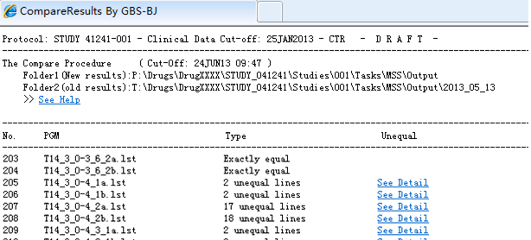
Efficiency and accuracy ( 1/5 )
Special function
  SendEmail
  Checklog
  Compare2Versi(oldDir=,newDir=)
  TitleFnote
  And so on
    Compare 2 version of output, and list all results in detail, hyperlink and located unequal lines with highlight by html.
    Easy for medical writer or biostatistician to find the small change between two version outputs and locate it.

Slide 16
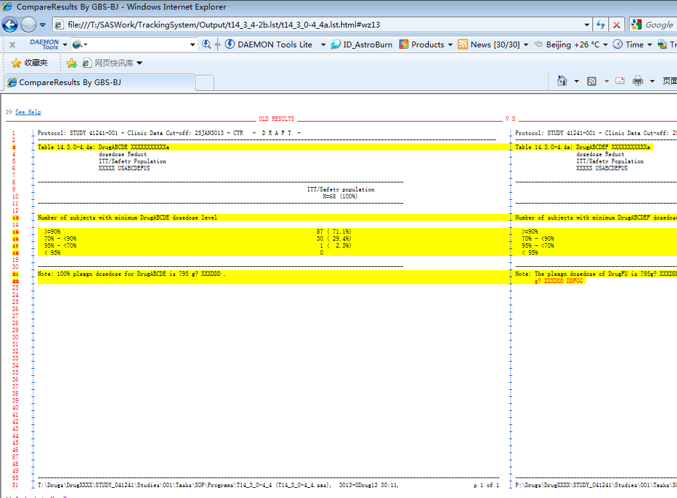
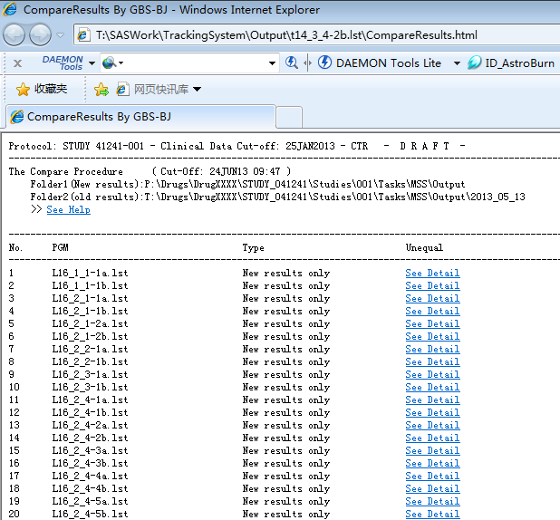
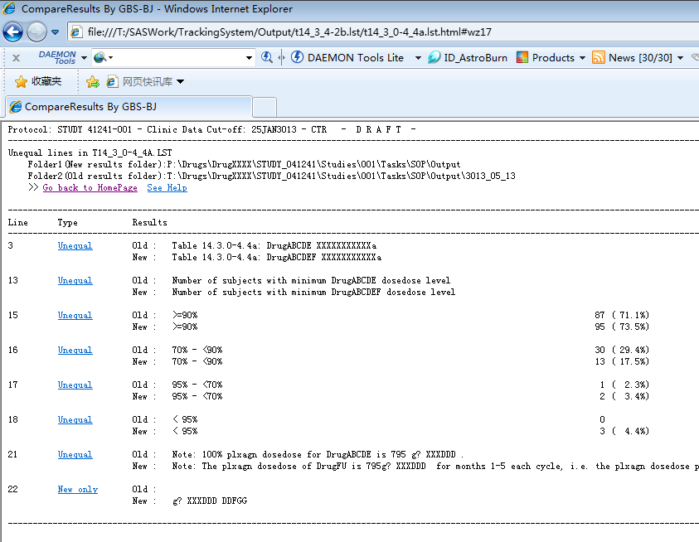
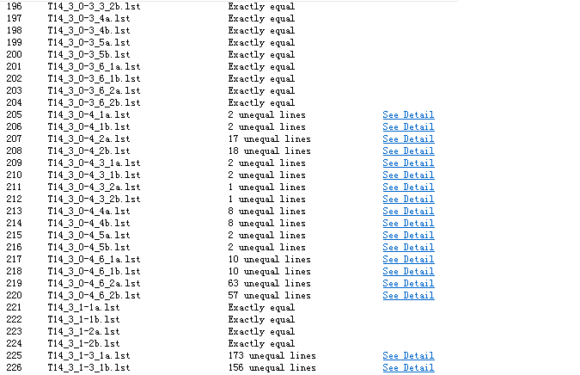

Slide 17
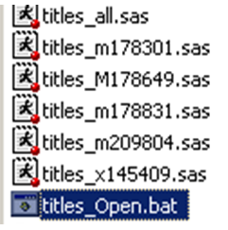
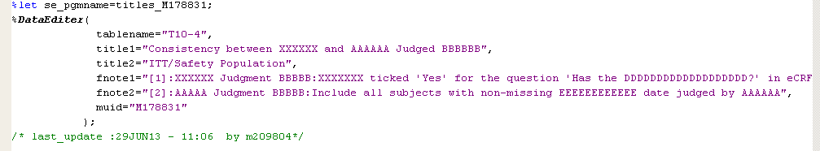
Efficiency and accuracy ( 2/5 )
Special function
  SendEmail
  Checklog
  TitleFnote
  Compare2Versi(oldDir=,newDir=)
  And so on
    Titles or footnotes in each SAS file would be difficult to make changes in batches, but it is easy to be modified by multi-users.
    Titles or footnotes in Excel File should be easy to make changes in batches, but could not be invoked by user if the file is opened simultaneously by another user.
    TitleFnote function have superiorities from above and will automatically match the titles and footnotes of Table/Listing .
    TitleFnote function is easy to be used for major programmer and validator. Just need a line size or NULL such as %fnote(150) ; or %fnote ;

Slide 18
Efficiency and accuracy ( 3/5 )
Titlefnote_M178831.sas
TitleFnote SAS file named by userID
Update
Real dataset
Open.bat
Update each Titlefnote_XXX.sas
Create /
modify
Update completed
Yes
Update titlefnote_all.sas
Update from
Titlefnote_all.sas?
Create
the latest copy
No
link the latest dateset
Titlefnote_all.sas
SAS file All
Combine all userID’s
SAS file
Update
Mirror image datasets

Slide 19
Efficiency and accuracy ( 4/5 )
Input
Xls or Folders
Datasets
    Only update related view and HTML.
Output
HTML or XML
Subject-level
Structure
BDs Structure
Project 001
Title.xls
Export
CSV
Project 001
tmpfolder
Project001
Predefine
Create / update
View
View N
View 2
Subpage N
HTML or XML
Basic
info
View 1
Subpage 2
HTML or XML
Project 002
Title.xls
Export
CSV
Project001
Subpage 1
HTML or XML
setIndex to DB
Project002
Project 002
tmpfolder
Project 003
Title.xls
Export
CSV
Predefine
Create / update
View
View N
View 2
Subpage N
HTML or XML
View 1
Subpage 2
HTML or XML
Project002
Subpage 1
HTML or XML
Import
Into
Dataset
setIndex to DB
Project003
Project 003
tmpfolder
Predefine
Create / update
View
View N
View 2
Subpage N
HTML or XML
View 1
Subpage 2
HTML or XML
Project003
Subpage 1
HTML or XML
setIndex to DB
Project 010
Title.xls
Export
CSV
Project010
Project 010
tmpfolder
Predefine
Create / update
View
View N
View 2
Subpage N
HTML or XML
View 1
Subpage 2
HTML or XML
Project010
Subpage 1
HTML or XML
Projects Folder
Projects Folder
Predefine
Getinfo and
Update
setIndex to DB
Predefine
Create / update
View
Home page

Slide 20
Efficiency and accuracy ( 5/5 )

Slide 21
Summary
By using this system, it has been demonstrated that we could reach our GOALs :
  Providing up-to-date information of projects progress
Reducing time and costs
Improving efficiency and accuracy
  Collecting data/information from different projects and making a follow-up analysis to benefit management team making decisions of future work

Slide 22
Prospect
Optimization activation mechanisms
  A Web-page SAS Editor and Submit without local SAS website system has been developed well based on JavaScript and JAVA.
  Integrate Tracking System and Web-page SAS function
    User can get the latest information by clicking on a button on the Webpage instead of by running programs.
    Administrator will be able to develop program on Webpage to explore advanced functions.
    Administrator could implement more tracking functions on Webpage by using Web-page SAS Editor.
  Expend functions and have the system utilized across departments/organizations
    Improve efficiencies per tracking, organizing, and reminding purposes.
    Could be integrated into other system to reach more achievements.

Slide 23
Thank you !
Email:
Zheng.Wang@Merckgroup.com
Yuntian.A.Zhao@Merckgroup.com
Yanhong.Li@Merckgroup.com

