Slide 1
SAS® Data Query and
Edit Checks with HTML5
PharmaSUG China 2012
Sy Truong, Meta-Xceed, Inc., Fremont, CA

Slide 2

Overview
Data Step to HTML5 Google Like Query
Functionality First
Software Validation
Implementation Lesson Learned
Concluding Thin Client Suggestions

Slide 3

"We have found that offering a high-quality user experience leads to increased traffic and strong word-of-mouth promotion."
- Sergey Brin
Co-Founder Google

Slide 4
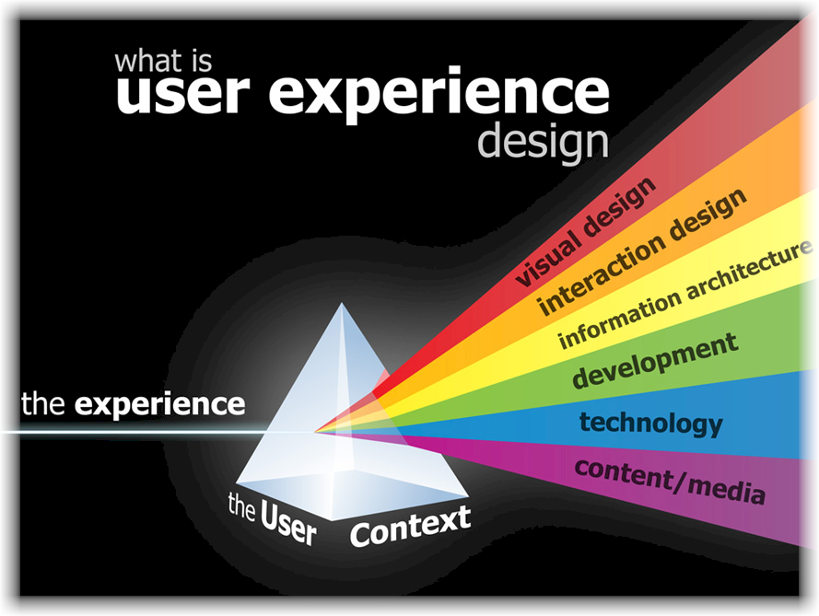
Data Step to HTML5 and XML
Obtaining Optimal User Experience
Desktop to Flash to HTML5
Users Expect Google, Facebook and Amazon
Delivery DATA STEP and SQL to All Users

Slide 5
Functionality Driven Development
Browser Access
Searching and Viewing Data
Query Expression Builder
Compounded Queries
Derived Variables
Joining Data
Frequency and Means

Slide 6
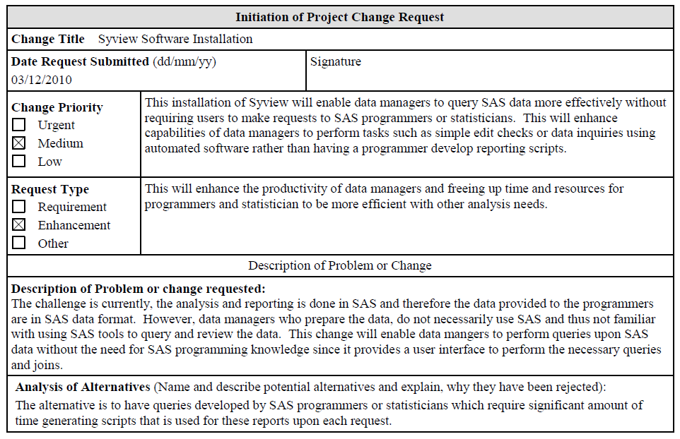
Formal Validation
Change Request

Slide 7
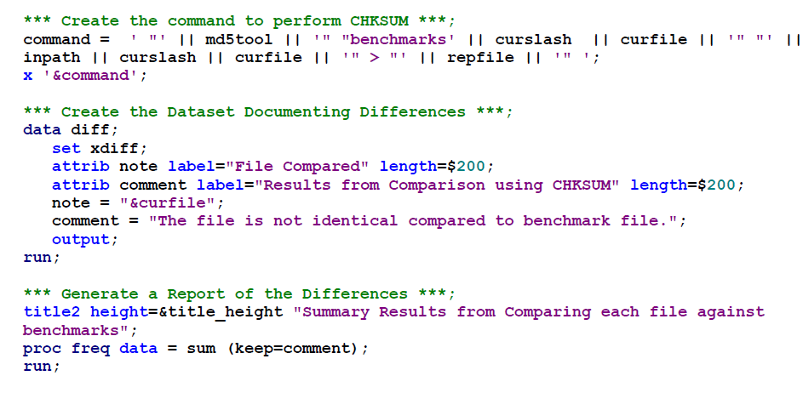
Formal Validation
Automating IQ – Installation Qualification

Slide 8
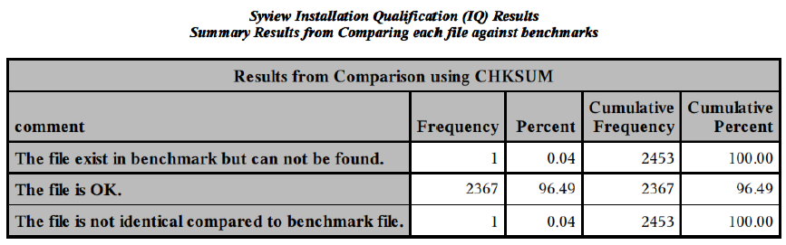
Formal Validation
Automating IQ – Installation Qualification

Slide 9
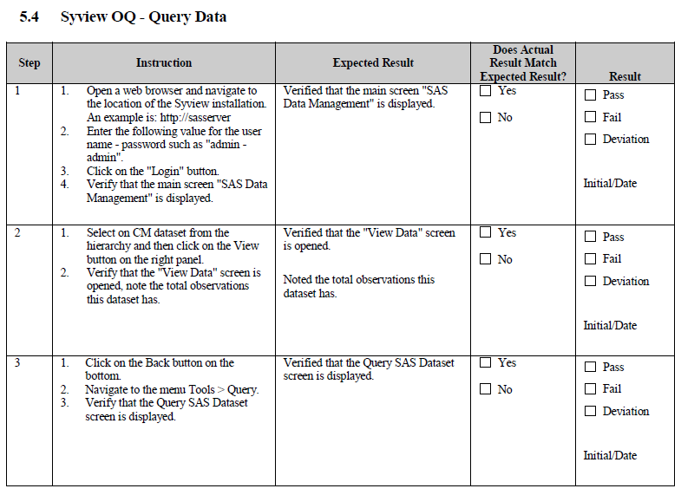
Formal Validation
Steps of OQ – Operational Qualification

Slide 10
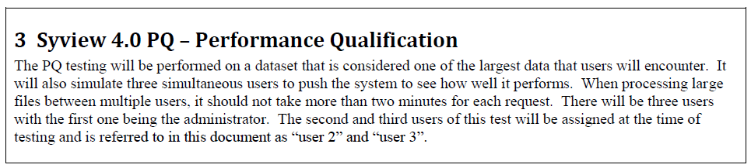
Formal Validation
Effects of PQ – Performance Qualification

Slide 11
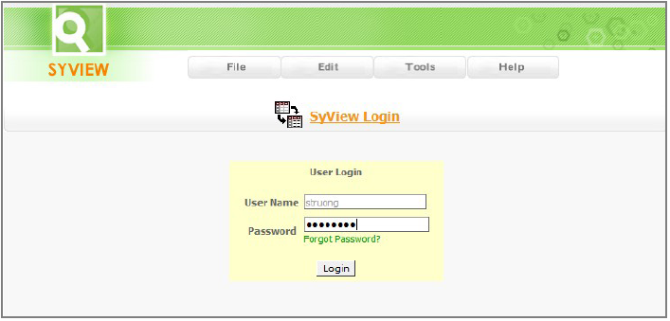
Software Implementation
Step 1 – Authenticate Users

Slide 12
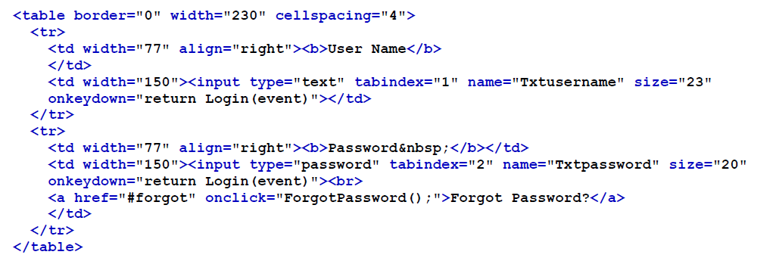
Software Implementation
Step 1 – Authenticate Users HTML Form

Slide 13
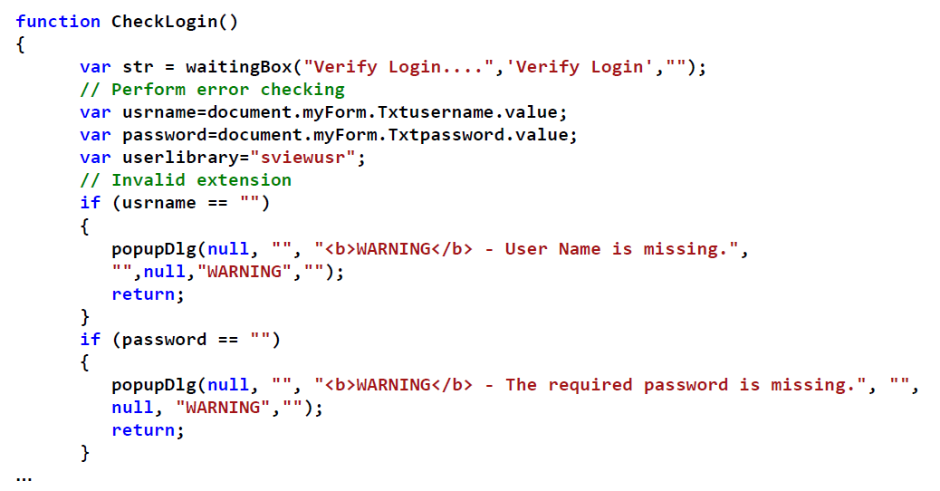
Software Implementation
Step 1 – Authenticate Users Error Check

Slide 14
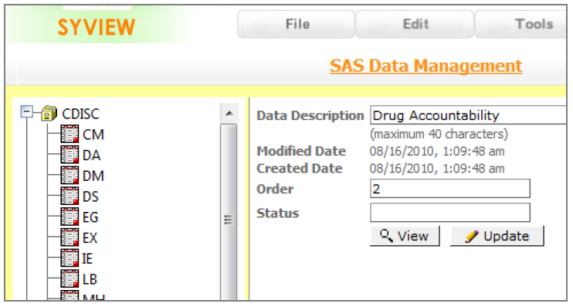
Software Implementation
Step 2 – Viewing SAS Datasets

Slide 15
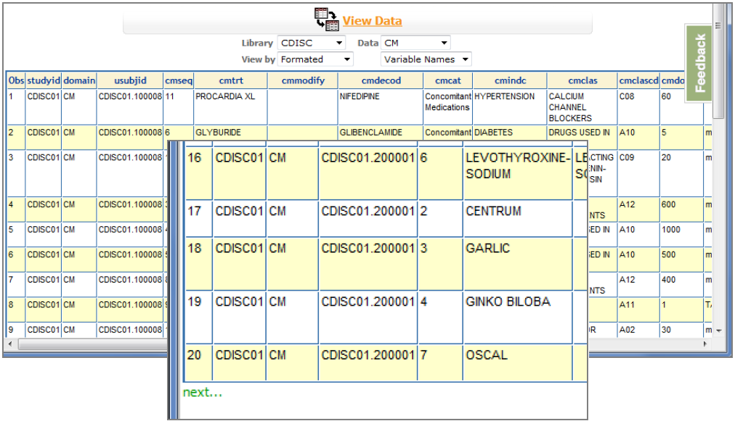
Software Implementation
Step 2 – Viewing SAS Datasets

Slide 16
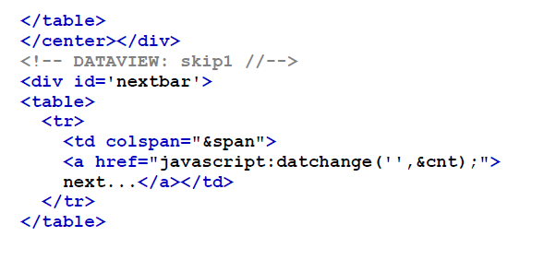
Software Implementation
Step 2 – Viewing SAS Datasets

Slide 17
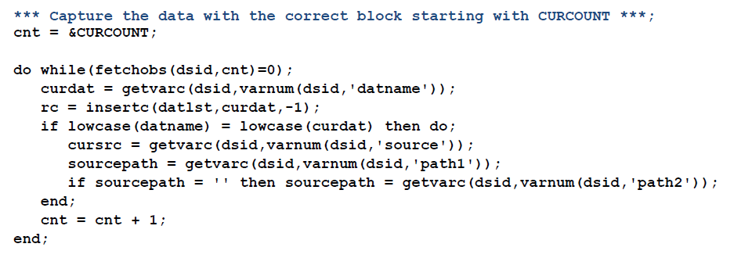
Software Implementation
Step 2 – Viewing SAS Datasets

Slide 18
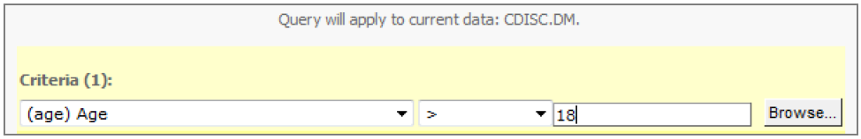
Software Implementation
Step 3 – Creating a Query
where age > 18 ;

Slide 19
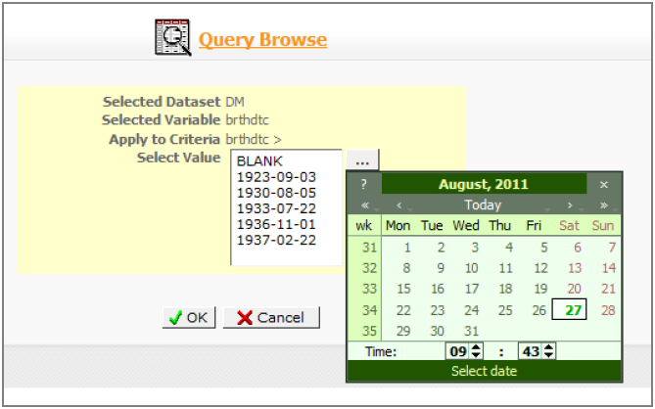
Software Implementation
Step 3 – Creating a Query

Slide 20
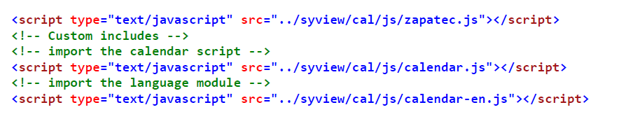
Software Implementation
Step 3 – Creating a Query

Slide 21
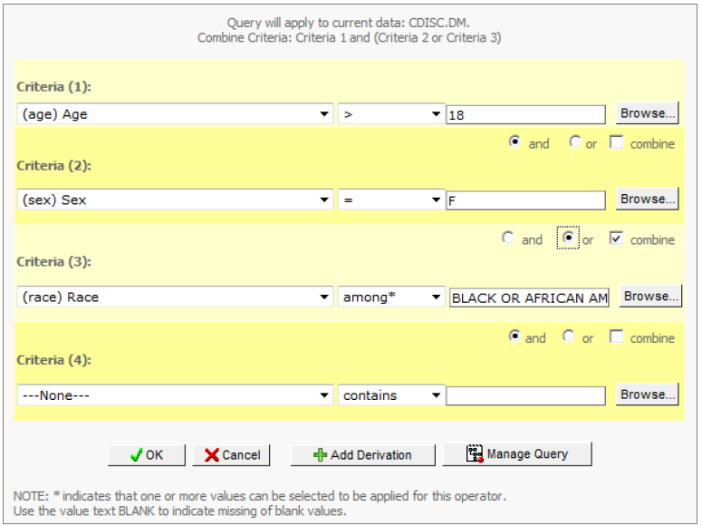
Software Implementation
Step 4 – Managing and Running Queries
Combine Criteria: Criteria 1 and (Criteria 2 or Criteria 3)

Slide 22
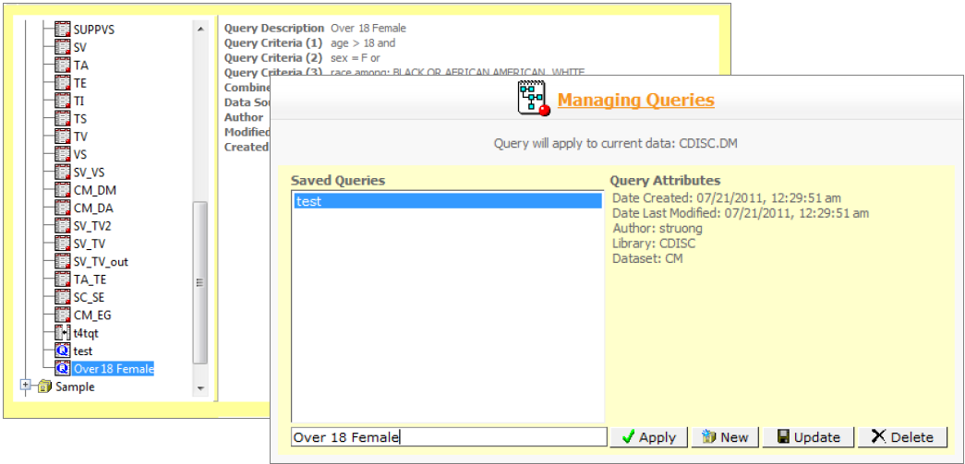
Software Implementation
Step 4 – Managing and Running Queries

Slide 23
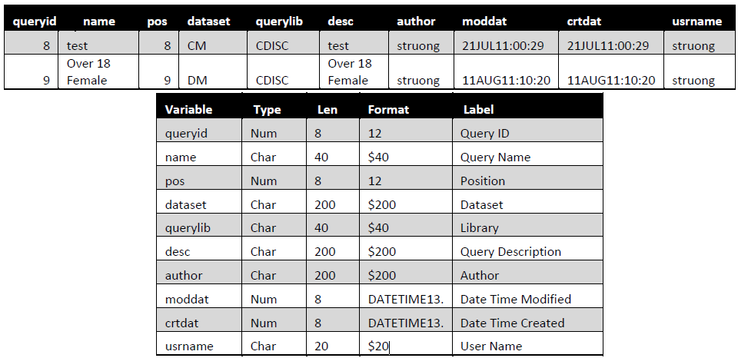
Software Implementation
Step 4 – Managing and Running Queries

Slide 24

Users Perspective
No Programming Necessary
No Installation Required
Ubiquity Access

Slide 25
Conclusion
Automate Task with User Interface
Simplicity of Google Like Interface
Marriage of HTML5 Frontend and SAS Backend
Minimal Approach is Effective

Slide 26

Sy Truong
E-mail: sy.truong@meta-x.com
26

